Slide 1
Hand sketch recognition with deep learning
Manjunath D

Slide 2
Introduction
We are implementing a convolution neural network which can determine users drawings .
We are using keras to build the convolution network.
We are using google “quickdraw dataset”.
We are also creating a interactive website to play with the trained model using Django.

Slide 3
Data set:
The Quick Draw Dataset is a collection of 50 million drawings across 345 categories, contributed by players of the game Quick, Draw!. You can browse the recognize drawings quickdraw.withgoogle.com/data.
Full dataset seperated by categories
Raw files (.ndjson)
Simplified drawings files (.ndjson)
Binary files (.bin)
NumPy bitmap files (.npy)
We are using simplified ndjson files to reconstruct 28x28x1 images.

Slide 4
Data set:
[
[ // First stroke
[x0, x1, x2, x3, ...],
[y0, y1, y2, y3, ...],
[t0, t1, t2, t3, ...]
],
[ // Second stroke
[x0, x1, x2, x3, ...],
[y0, y1, y2, y3, ...],
[t0, t1, t2, t3, ...]
],
... // Additional strokes
]

Slide 5
Modules used
TensorFlow : It is an open source artificial intelligence library.
Keras:Keras is a neural network library while TensorFlow is the open-source library for a number of various tasks in machine learning. TensorFlow provides both high-level and low-level APIs while Keras provides only high-level APIs. ... Keras is built in Python which makes it way more user-friendly than TensorFlow
NumPy : NumPy is the fundamental package for scientific computing in Python. It is a Python library that provides a multidimensional array object.
OS : The OS module in Python provides functions for interacting with the operating system.

Slide 6
Modules used
CV2 : OpenCV-Python is a library of Python bindings designed to solve computer vision problems.
Urllib : The urlretrieve() function provided by the urllib module. The urlretrieve () method downloads the remote data directly to the local.
Matplotlib : For plotting graphs.
Keras tuner :To find the best possible model architecture.
Visualkeras : To plot model architecture.

Slide 7
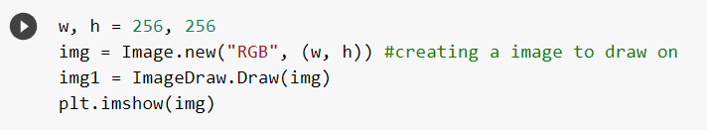
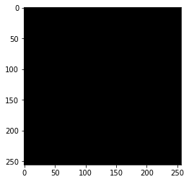
Data Preparation Stage 1:
Creating a image to draw the strokes.

Slide 8
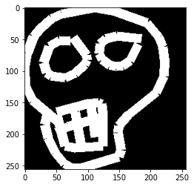
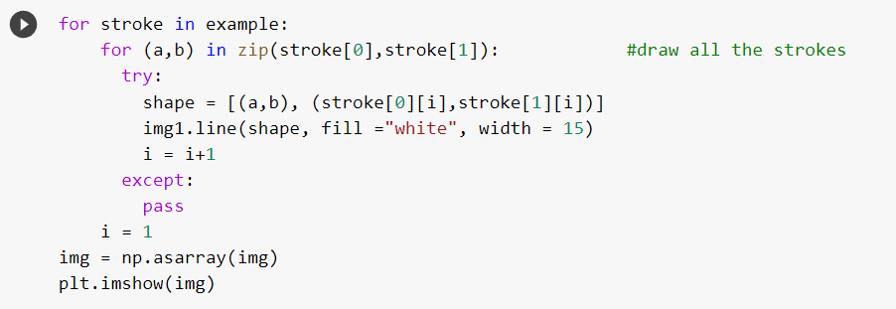
Data Preparation Stage2:
Drawing the strokes on created image.

Slide 9
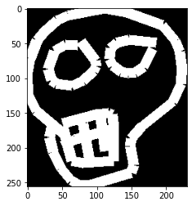

Data Preparation Stage3:
Deleting the empty columns

Slide 10
Data Preparation Stage4:
Deleting the empty rows

Slide 11
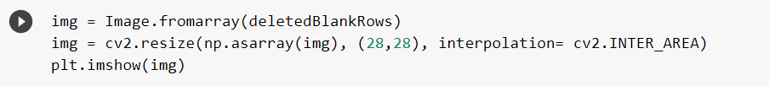

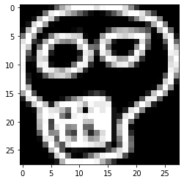
Data Preparation Stage 5 and 6:
Resizing and changing the color format

Slide 12
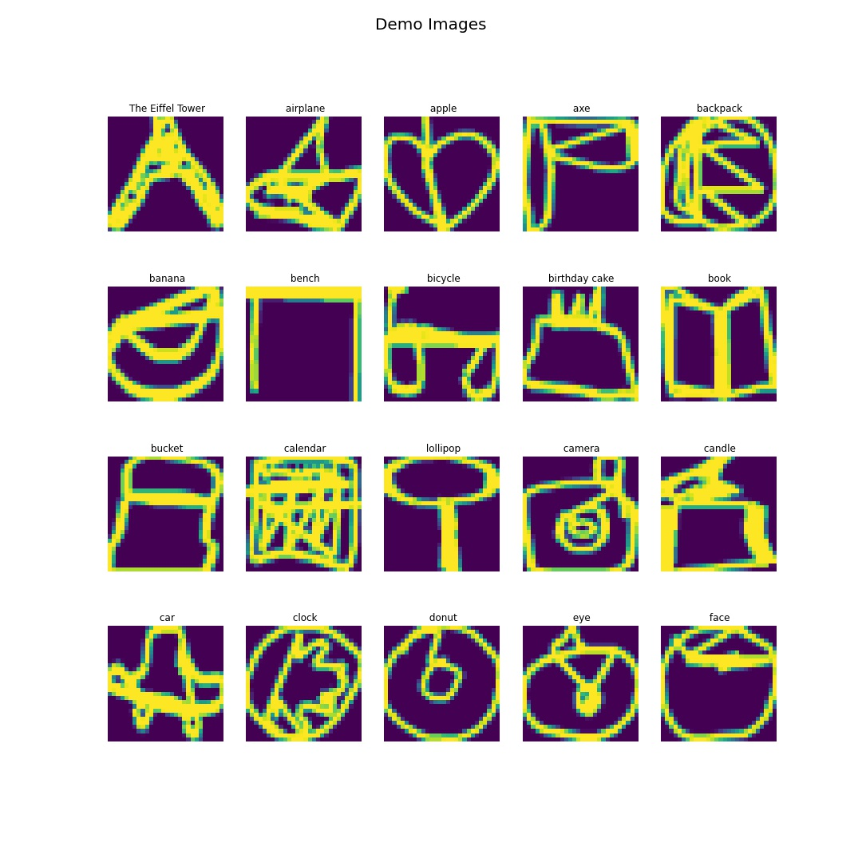
Examples :

Slide 13
Website architecture
website
server
model
server
prediction
Strokes
prediction
Image

Slide 14
Website architecture
User is instructed to draw a sketch(one from 20 categories).
User draw's the sketch on website which is sent to server.
The strokes are converted to image in server.
The image is fed to model which gives prediction.
Prediction is sent back to website.
If the user succeeds in drawing the image then he is given the next image.
Above steps are executed in a interval of 3 seconds.

Slide 15
Model architecture
We are using Sequential model to implement CNN.
This CNN is made up of 12 layers
First layer is the input layer which takes 28x28x1 as input.
Then the next 6 layers are alternating Conv2d and Max-pool layers
Conv2d produce feature maps and max-pool layers reduce the dimensions of feature maps.
8th layer is a dropout layer with a value of 0.1 .
Drop out layers drop some neurons randomly on every epoch to prevent overfit.
9th layer is flatten layer .which converts multi dimensional tensors to 1D array.
10th and 11th layers are Dense layers with 1000 nodes each.
12th layer is output layer which has 20 nodes , to predict 20 classes.

Slide 16
Model architecture
Conv2d and Dense layers are using Relu as activation functions.
Both conv2d and max-pool are using kernel of size 2x2.
Output layer is using SoftMax to perform multi-category classification.
Loss function used is categorical cross-entropy.
Optimizer used is Adam optimizer with learning rate 0.001.
Outputs and inputs of each layers are explained in next slides.

Slide 17
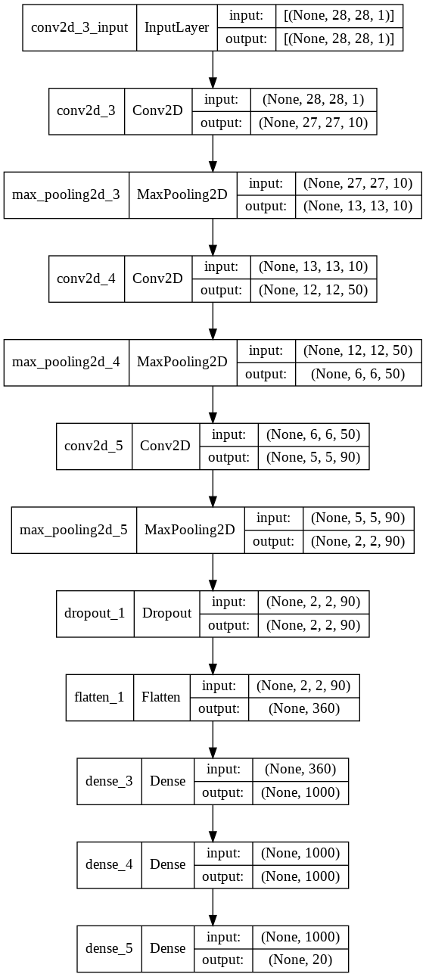
Model architecture

Slide 18
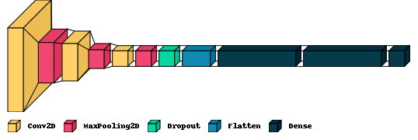
Model architecture

Slide 19
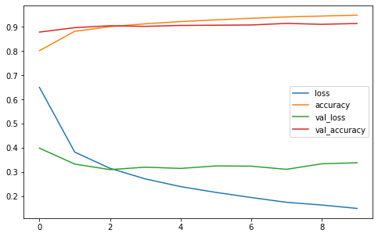
Result analysis
This CNN model achieved accuracy of 94.83% over 10 epochs.
Model started to overfit slightly from epoch 4.

Slide 20
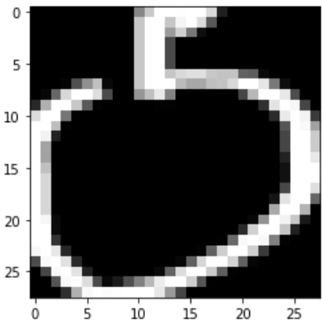
Result analysis
The input layer receives input as shown in the image.
The first convolution layer produces 10 feature maps of size 27x27.
First MaxPool layer reduces the dimension of Feature maps to 13x13.
Second convolution layer produces 50 feature maps of 12x12.
Second MaxPool layer reduces the dimension of Feature maps to 6x6.
Third convolution layer produces 90 feature maps of size 5x5.
Third MaxPool layer reduces the dimension of Feature maps to 2x2.
Initial Input

Slide 21
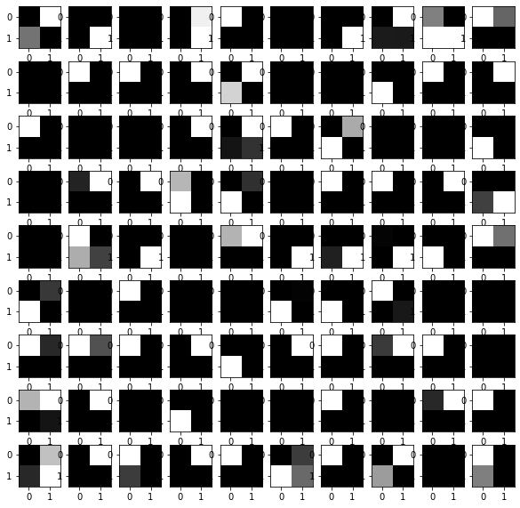
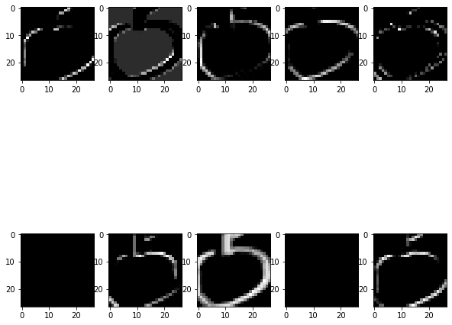
Result analysis
First layer convolution
Last Max-Pool layer

Slide 22
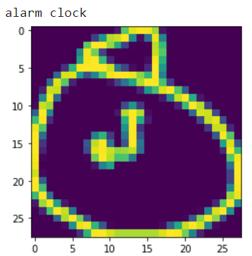
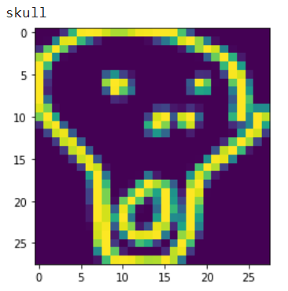
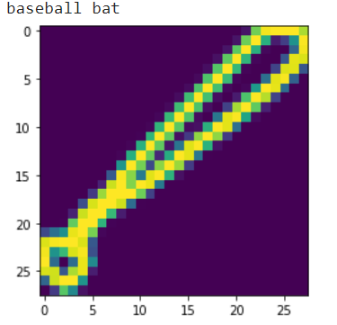
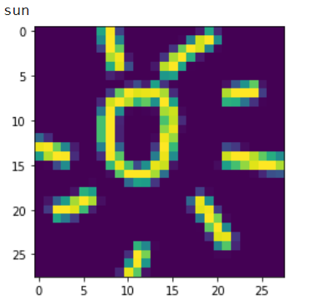
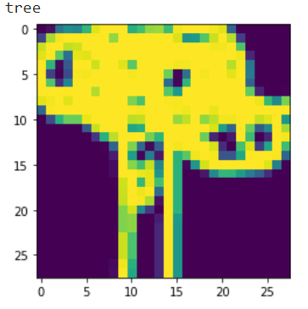
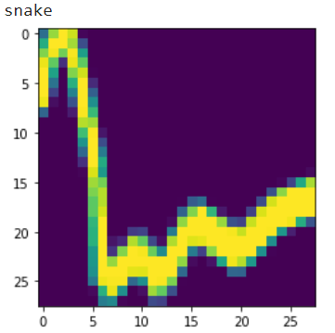
Testing
Some of the predictions from the model

Slide 23
Conclusion
Convolutional Neural Net is a popular deep learning technique for current visual recognition tasks. Like all deep learning techniques, CNN is very dependent on the size and quality of the training data. Given a well prepared dataset, CNNs are capable of surpassing humans at visual recognition tasks. However, they are still not robust to visual artifacts such as glare and noise, which humans are able to cope.

Slide 24
Thank you
Link for google collab notebook → click here

